Slide 1
FANDANGO MOVIE RATINGS DISCREPANCY ANALYSIS USING PYTHON
CAPSTONE PROJECT
Presented By:
BHARATHI.A
MECHANICAL ENGINEERING (3RD YEAR)
ROEVER ENGINEERING COLLEGE-PERAMBALUR

Slide 2
OUTLINE
Problem Statement
Proposed System/Solution
System Development Approach
Algorithm & Deployment
Result
Conclusion
Future Scope
References

Slide 3
Problem Statement
In this, we have to predict the number of positive and negative reviews based on sentiments by using different classification models.
The process should be analysis from the dataset of the movie rating of all sites scores collecting from the base of data.
To compared between the movies scores vs ratings

Slide 4
Proposed Solution
Movie is one of the biggest industries in the world. It is one of the mainstream entertainment media. However, recent studies say only a few movies succeeded or satisfied viewers.
Movie makers are desperate to know the viewers’ reactions and sentiments to the movie. Maximum of the previous research works ware on movie hit prediction. Significantly, few works accurately predict the IMDb rating of an upcoming movie. Very few works analyse the viewers’ sentiment before and after the movie’s release. In our research work, we extract the YouTube comments of 80 selected movies. Then, we analyse the sentiment of each review comment using the VADER lexicon. Next, compute the overall sentiment and predict the IMDb rating of each movie.
In the second part of our work, we investigate the viewers’ sentiment trends pre- and post-release of the movie. We have achieved 0.4702 mean square error and 0.519 is R2-score. Our observed results proved that the forecasted rating of pre-released movies had the lowest error. Our analysis helps to support industry decisions.

Slide 5
System Approach
Systes requirements:
Hartware :
-a computer with sufficient processing power preferable with multible cores or a GPU for faster training of machine learning models.
- adequate RAM to handle the size of the dataset and computational requirements.
2. Software :
- an operating system compatible with the required machine learning libraries (windows ,linux ,

Slide 6
Algorithm & Deployment
Predicting IMDb Movie Ratings using Supervised Machine …
The idea is that artists in the movie industry can utilize this model to predict how well a movie will be received by viewers, thus, focusing on IMDb rating as the target, rather than Metacritic’s rating system or Rotten Tomatoes’s Tomatometer. In its entirety, this project explored a few critical skills required of a data scientist:
Deployment and Challenges
Deploying a movie recommendation system involves integrating it into a platform like Netflix or a custom web app. Challenges include scalability, real-time updates, and handling cold starts (when a new user or item joins the system).

Slide 7
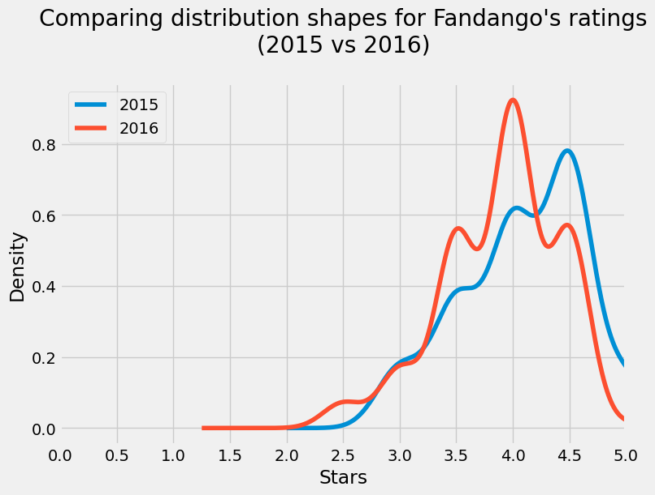
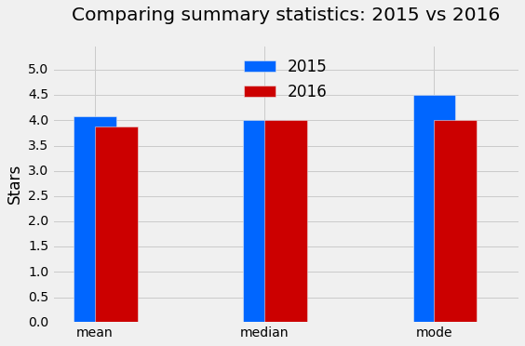
Result

Slide 8
Conclusion
Express Your Opinion Clearly: Don’t leave the reader guessing whether you liked the movie or not. State your opinion early on and then elaborate on it throughout the review. You can use stars, a numerical score, or a simple thumbs-up/thumbs-down to convey your thoughts:
Great Movie: “ABC is the rare movie that succeeds on almost every level, where each character, scene, costume, and joke fire on all cylinders to make a film worth repeated viewings.”
Bad Movie: “With 47 Ronin, you’re better off saving your money, your popcorn, and time.”
Okay Movie: “I loved the wildly uneven Interstellar far more than I should have, but that doesn’t mean it is perfect. Ultimately, the utter awe and spectacle of space swept me through the admittedly heavy-handed plotting and dialogue.”

Slide 9
Future scope
Socially Conscious Ratings:
the future of movie ratings will be more dynamic, responsive, and reflective of our evolving society. As technology and perspectives change, so will the way we evaluate and appreciate films.
Socially Conscious Ratings:
Movie ratings will increasingly reflect societal values and ethical considerations. Films that address important social issues, promote diversity, or challenge norms will receive recognition.
Audiences will demand more responsible representation and accurate portrayals of various communities. Inaccurate or harmful depictions may lead to lower ratings.

Slide 10
References
Matplotlib https://www.w3schools.com/python/matplotlib_intro.asp
Pandas https://www.w3schools.com/python/pandas/pandas_csv.asp
Dataframe https://pypi.org/project/sort-dataframeby-monthorweek/
Kaggle Find OpKaggle: Your Machine Learning and Data Science Communityen Datasets and Machine Learning Projects | Kaggle

Slide 11
THANK YOU

